Slide 1
Business Requirement Specifications Document
Project Name : Q-Project
Prepared By : Defenders and Fire Birds
Prepared For : Business Requirement
Analysis
Date of Submit : 27-03-2023

Slide 2
Q-Project
Client Requirements:
login page (Super Admin, Users, Clients)
Client details form
User details form
Client Report (Campaign)

Slide 3
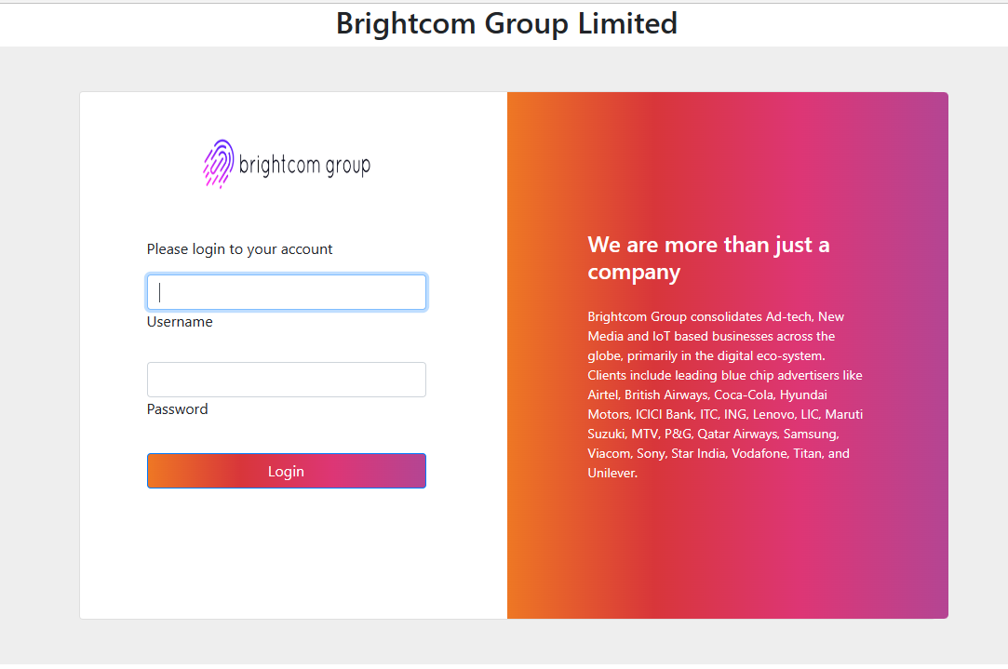
Q-Project
Login Page(Super Admin, Users, Clients)

Slide 4
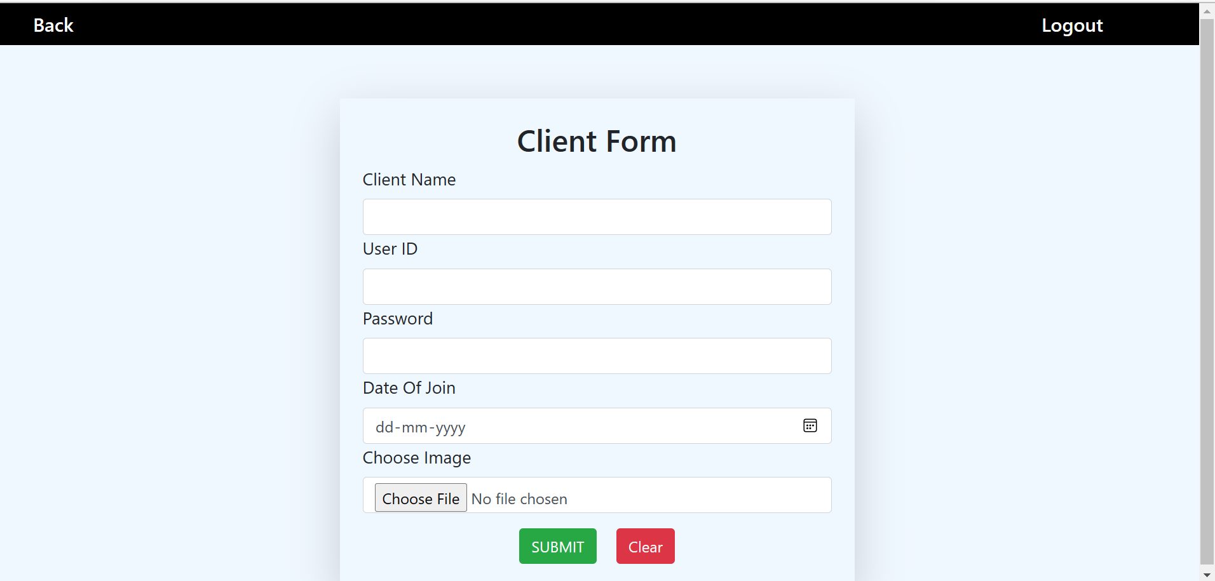
Q-Project
Client Details Form

Slide 5
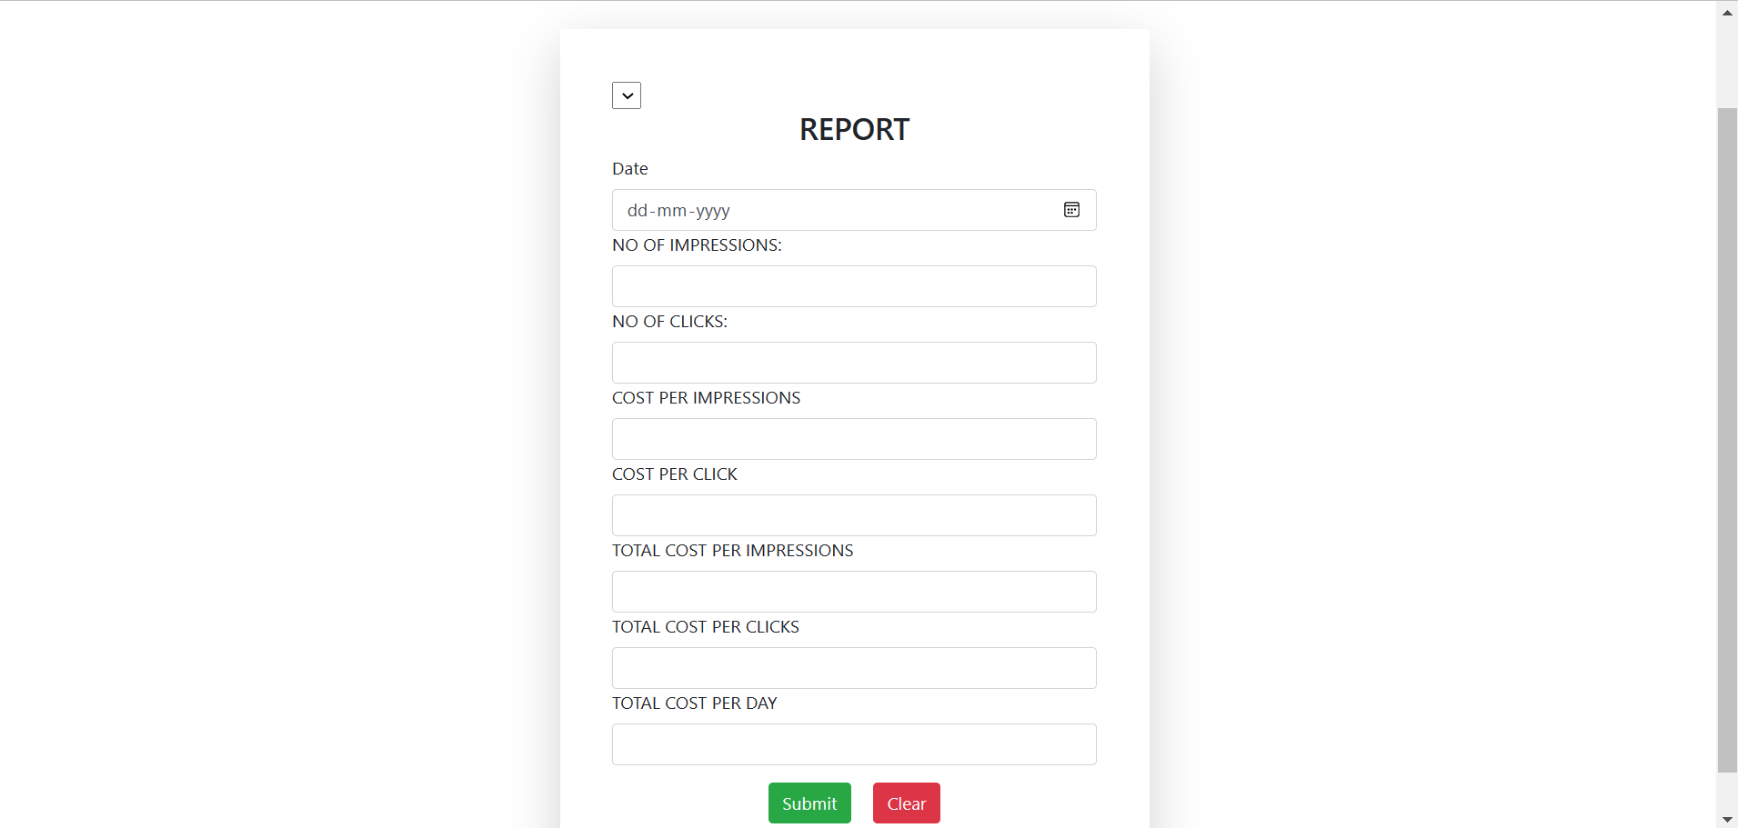
Q-Project
Client Report

Slide 6
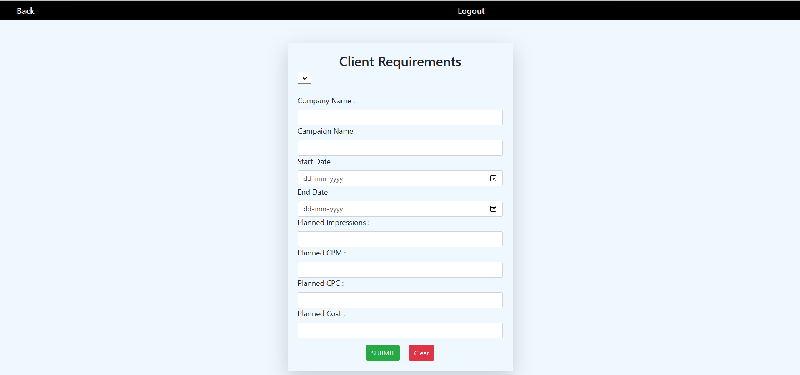
Q-Project
User Details Form

